Slide 1

Power Point 2010
A JAWS 12 Odessy
(press the space bar to continue)

Slide 2
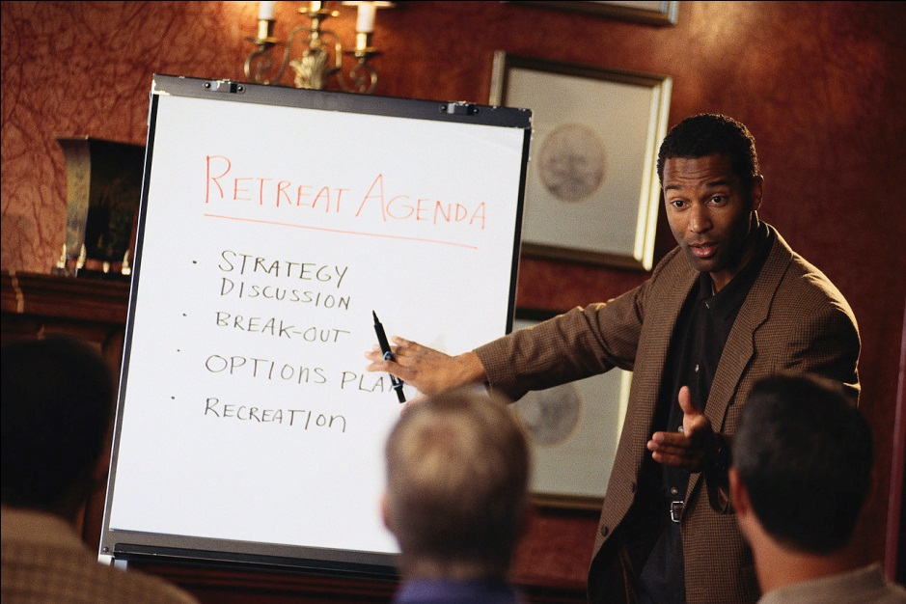
Playing a Presentation
    To start a presentation hit f5
    To go to the next slide hit the spacebar
    To go back to the previous slide hit backspace

Slide 3
Definitions
presentation: this refers to all of the slides, sounds, videos, and effects.
slide: the individual units in a presentation. It will contain text, pictures, charts, and other items
placeholder: the elements that make up a slide. They are smaller boxes within the box of the slide.
title placeholder: the placeholder at the top of the slide that contains the title of the slide
object placeholder: a box that contains the slide contents. This text you are now reading is in a object placeholder.
layout: the arrangement of placeholders on a slide
To move from one object on a slide to another, press tab.

Slide 4
Parts of the Power Point Screen
When you are creating a presentation, the Power Point has several sections. You can move between these panes by hitting f6 and shift-f6. This will also take you into the ribbon.
The notes pane contains notes that the presenter uses during the presentation. The thumbnail pane shows the order of the slides. This is where you can delete, move, or copy slides. The slide area is where you put content on your slides. The task pane is where you can select clipart or other items to insrt into your slide.

Slide 5
Creating slides
  A basic slide, like this one, contains a title placeholder and an object placeholder. To insert a new basic slide, hit control-m.
To switch between slides press page up and page down.

Slide 6
Putting Content on a Slide
To move from one placeholder on a slide to another, press tab.
To interact with a placeholder, hit enter.
To stop interacting with a placeholder, press escape.

Slide 7

Themes and Backgrounds
An easy way to create a consistent look for a presentation is to use a design theme. When you choose a theme, Power Point alters many of the visual effects of all slides to match the specifications of that theme. This includes the font, text color, text size, and bhackground color.
The theme for this presentation is called elemental. However, the background for this slide has been changed to a picture of penguins. This might sound like a fun thing to do, but it actually made the text hard to read fisually. JAWS can read it fine, but if you were to press insert-f to check the font right now, JAWS will not give you a constent color reading. So the moral of the story is: simple is usually the best way to go and always go over any iportant presentation with a reader to make sure it is exactly how you want it. By the way, this text is also a design nightmare because it contains way too much text.
To change the background for a paticular slide, press the application key while that slide is active and choose format picture from the menu. Note: you wil get different options in your context menu depending on whether you are interacting with a placeholder, on the object level, or in the thummbnails pane.

Slide 8
Transitions
Transitions are the audio and visual effects that power point uses to flip from one slide to another. You can use the transitions tab in the ribbon to set your transitions. . You can use a transition cheme to use the same effect for all slides.

Slide 9
JAWS Commands
Say Font INSERT+F
Say object dimensions and location CTRL+SHIFT+D
Say selected object INSERT+SHIFT+DOWN ARROW
Say shape animation information CTRL+SHIFT+A
Say slide information CTRL+SHIFT+S
Show a list of comments associated with the current slide CTRL+SHIFT+APOSTROPHE

Slide 10
More JAWS Commands
Follow selected hyperlink CTRL+SHIFT+ENTER
View a list of hyperlinks in the current slide INSERT+F7
Read table column by column INSERT+SHIFT+C
Toggle table reading method CTRL+SHIFT+T
Read table row by row INSERT+SHIFT+R
Read notes in Normal or Slide Show view CTRL+SHIFT+N

Slide 11
Still More JAWS Commands
Say status bar information INSERT+DELETE
Say PowerPoint version CTRL+INSERT+V
Read spell check dialog INSERT+F7
Select an object on current slide CTRL+SHIFT+O

